Slide 1


Part-2 Security Technologies Recommendations
Name: 1) SHRUTIKA KOLHE
ID-200531846
2 )VRUSHAL GOGARI
ID-200528070
3) DWEEJ KOTHARI
ID-20052
PROFESSOR: NITAL SHAH

Slide 2
PROJECT SUMMARY
In the execution phase, we have created an ASP.NET Core web app with user data protected by authorization. It displays a list of contacts that authenticated (registered) users have created. There are three security groups:
Registered users can view all the approved data and can edit/delete their own data.
Managers can approve or reject contact data. Only approved contacts are visible to users.
Administrators can approve/reject and edit/delete any data.

Slide 3
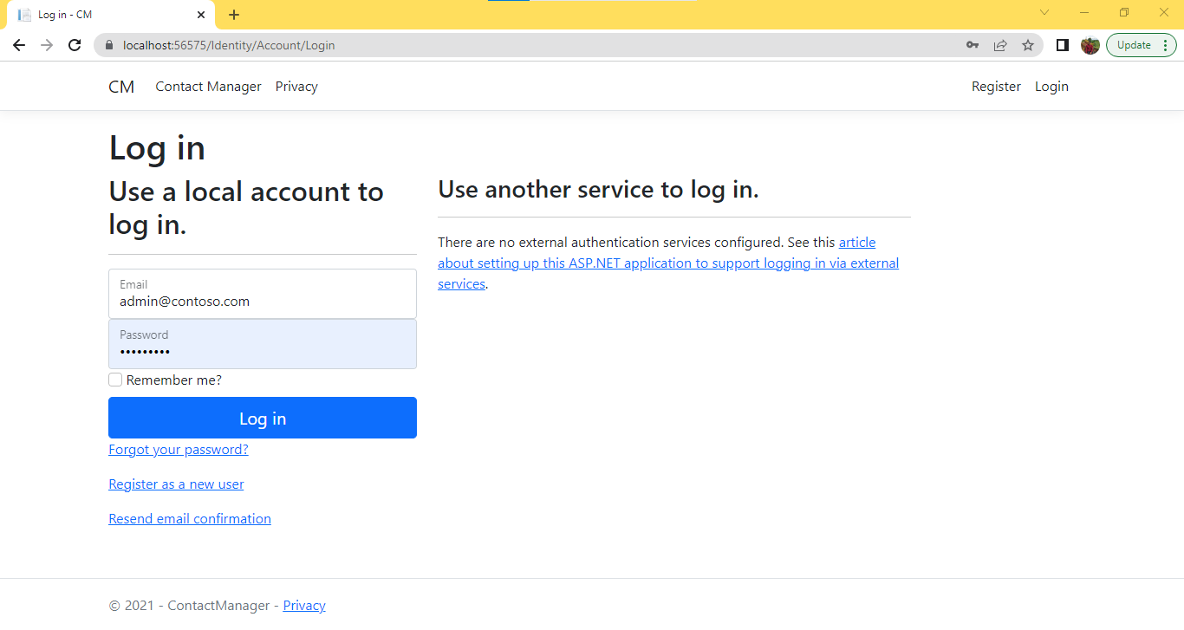
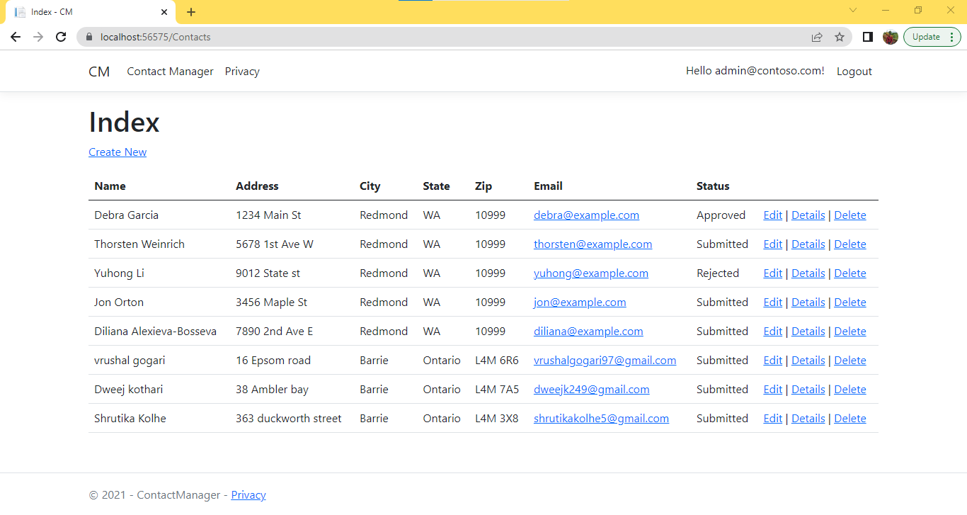
PART-1 DEMONSTRATION ADMIN LOGIN

Slide 4
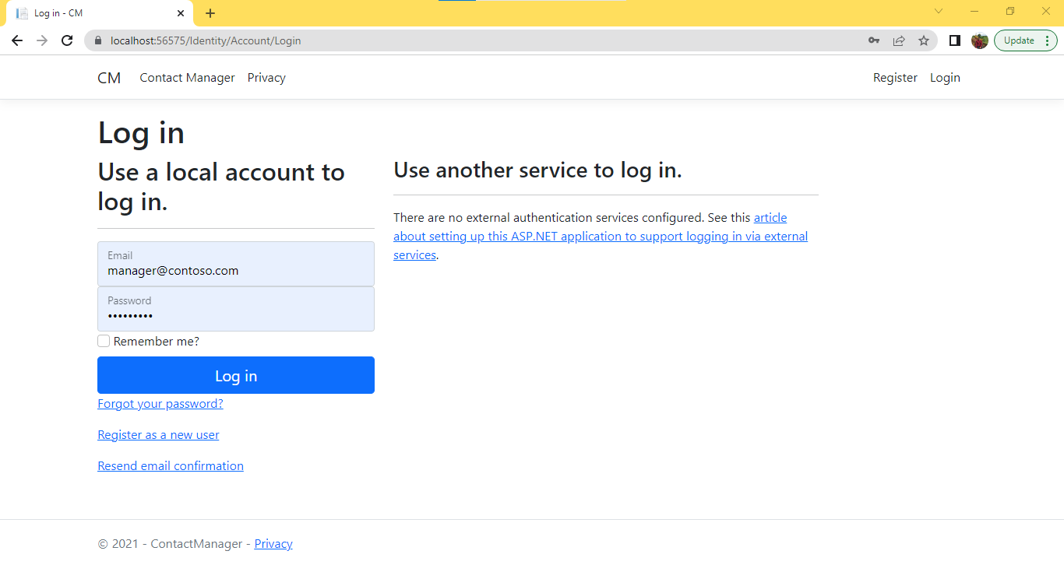
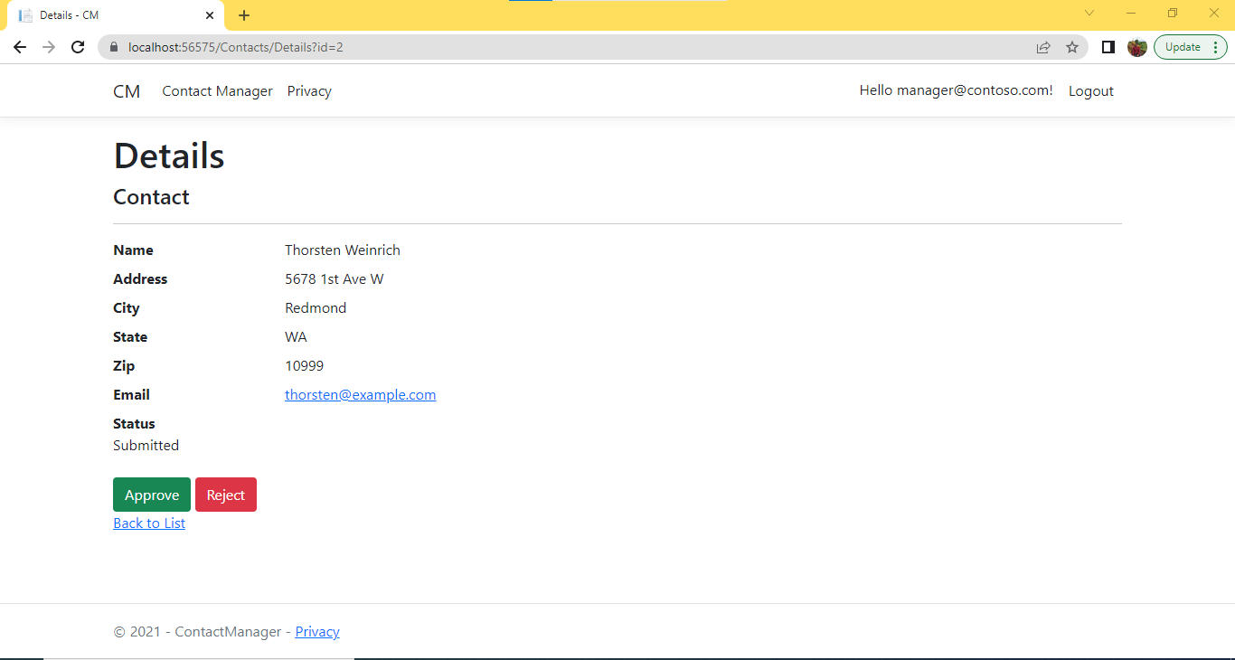
MANAGER LOGIN

Slide 5
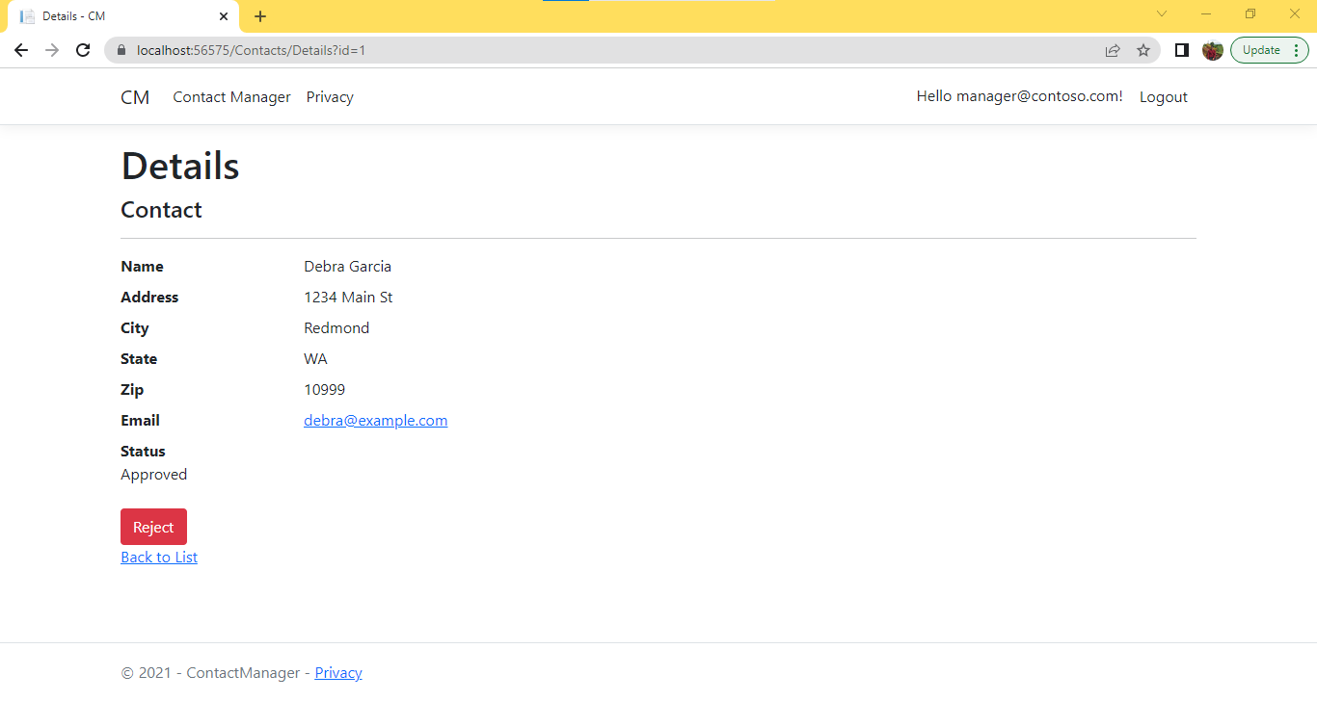
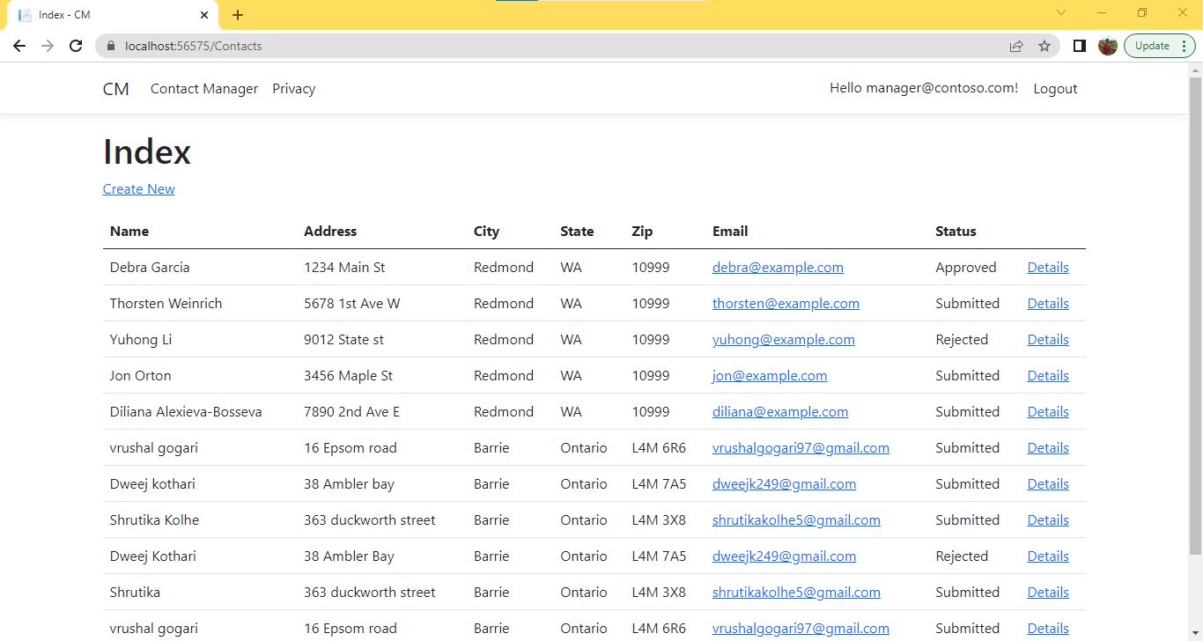

Slide 6
ADMIN LOGIN

Slide 7
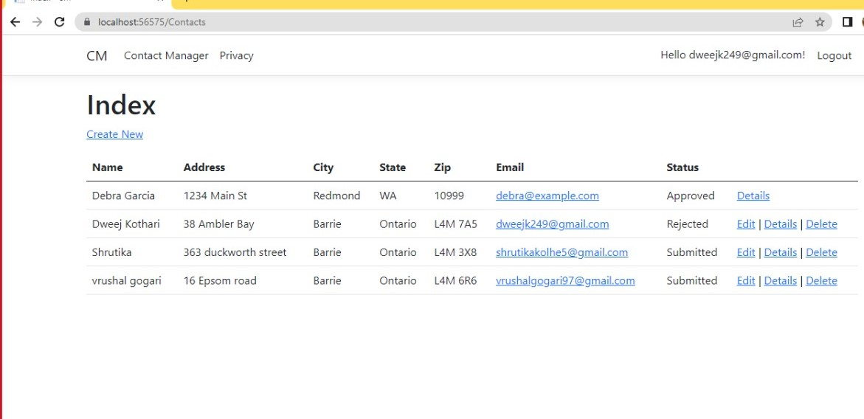
USER LOGIN

Slide 8
1) How can we transfer personal data securely within their network?
We use HTTPS, which combines the SSL (secure Socket Layer)/TLS (Transport Layer Security) protocols to create an encrypted connection to an authenticated peer over an insecure network.

Slide 9
2) What security protocol is best for transferring personal files?
SFTP (SSH File Transmit Protocol) to securely transfer files from a local workstation to a server and from a server to a local machine.
SFTP operates over the SSH protocol, hence it provides and supports SSH's security and authentication features.
It functions similarly to FTP via a secure SSH shell connection. As a result, SFTP provides an additional level of protection while transferring data.
After connecting to the server through SFTP, we can begin uploading files, where we may transfer various files from our local system to the web server.

Slide 10
3) Can we encode and encrypt images?
Yes, we can encrypt photos just like the software which encrypts text. Using an algorithm known as Secure Algorithm, which does a variety of mathematical operations on binary data that makes up a picture in a predictable manner

Slide 11
4)Our database cannot be moved from the site, and we need to be able to access it externally using a secure API. Can you explain the architecture of a secure API?
We may utilise API architecture to build our web application, which allows various apps to interface with applications, middleware systems, and databases.
The architecture of secure API works as follows:
1)When a user requests a certain page by delivering a URL, the server responds by sending a file to the browser.
The browser then executes these files to display the requested page to the user. Where the user may interact with the website.
1- The code that runs in the browser and reacts to user input.
2- The server-side code that replies to HTTP requests

Slide 12
2)Postman was used for creating and saving basic and sophisticated HTTP/s requests, as well as sharing, testing, and documenting APIs. This enables users to build and preserve basic and complicated HTTP/s requests and responses, resulting in more efficient operations
REST—REST or RESTful API architecture (Representational State Transfer) utilised for designing Web APIs that take advantage of HTTP.
REST API Implementation Operations:
The mapping of CRUD operations to HTTP methods
Making resources
resources are being updated.
removing resources
RESTful operations are being tested.
PUT and DELETE methods emulation

Slide 13
5) Can you recommend a secure framework for coding an API?
According to me REST API Authentication is best method to Secure Our Web API. it consists of:
1.Third-Party Certificates for Client Security HTTP Basic Authentication through Accounts
2.Authentication through HTTP Digest.
3.Authentication Using an API Key....
4.Using a Java Web Token for Authentication (JWT).
5.Authentication with oAuth
so, looking at the above features I will suggest using REST Authentication method

Slide 14
6) What data interchange format should we use while transferring data between locations?
JavaScript Object Notation, or JSON, as we all know, is a well-known, lightweight data- interchange format that is readily readable/writable. Machines can also easily parse and produce it. JSON is built on data objects that are made up of attribute-value pairs and array data types.
It is commonly used for asynchronous browser-server communication, including as a substitute for XML in certain AJAX asynchronous data retrieval examples single page application.

Slide 15
7) How should we store our data in our many locations?
- I went to the websites listed in the links, which were hosting.com, box.net, mydocsonline.com, and mozy.com. It provides a 15-day trial period, which means we may utilise some of the main features for 15 days and then pay if we want to continue using those resources. It will allow numerous users with various passwords to access your storage space because once we purchase and use it, we will be the admin and will be able to create multiple users and assign them passwords to view our data. It is quite safe to keep any of your company and employee data

Slide 16
8) What are the ethical concerns related to the transmission of personal data?
The following are ethical considerations around the transfer of personal data:
DATA SECURITY: Protecting and keeping your (digital) data safe against attack, unintentional deletion, security breaches, and everything else that might happen to it.
DATA PROTECTION: Information systems cannot execute their jobs unless their data is correct and full. As a result, data loss or corruption pose a significant risk.
DATA/INFORMATION PRIVACY: Privacy issues arise whenever personally identifiable information or other sensitive information is gathered, kept, utilized, and eventually destroyed or erased - whether in digital or non-digital form. Improper or non-existent disclosure control might be the source of privacy concerns.

Slide 17
Thank You

